Slide 1
OVERVIEW
Problem/Question
According to the Australian Antarctic Program (2022), there are a total of 18 species of penguins currently know, 5 of which line in Antarctica, and 4 other live on sub-Antarctic islands. For researchers, it is very important to differentiate among species to better understand mating patterns, eating cycles, and the overall development of penguins. Therefore, we believe it is important to leverage machine learning techniques to distinguish among species, and effectively predict the specie of a penguin given certain characteristics.
Objective
The goal of the project is to create Machine Learning models to predict the Species of the Penguins, and in a similar way to predict the Sex as well. We would like to compare the performance of different models build for predicting each target variable. The models would also be helpful in determining the influential features if any, in determining the
Species and Sex of the Penguins. It would be interesting to see if there are any similarities or differences in the features that are most influential in determining the two target variables.
Summary The analysis starts with carrying out Exploratory Data analysis and preparing the data for further analysis. The Analysis is further divided into two parts. Part 1 Focuses on building different models for predicting the Species of Penguins and comparing and analyzing them. We follow the same approach in Part 2 to predict the Sex of Penguins. Importance of features in predicting both the Species and Sex is determined and compared.
Data References:
Australian Antarctic Program (2022) About Antarctica, Animals, Penguins. https://www.antarctica.gov.au/
Gorman KB, Williams TD, Fraser WR (2014) Ecological Sexual Dimorphism and Environmental Variability within a Community of Antarctic Penguins (Genus Pygoscelis). PLoS ONE 9(3): e90081. doi:10.1371/journal.pone.0090081

Slide 2
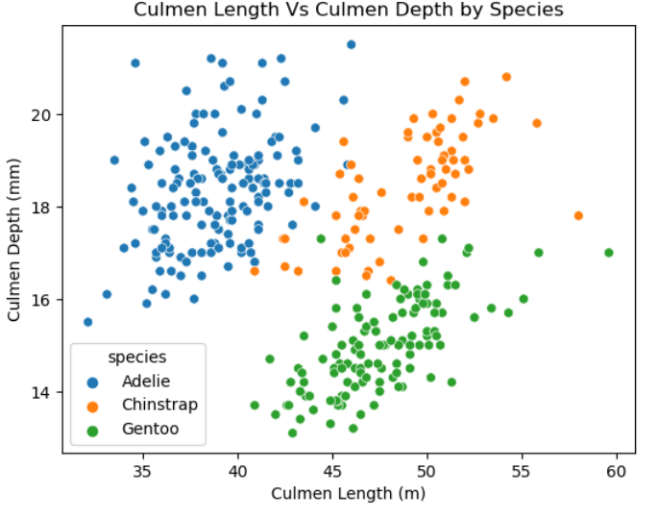
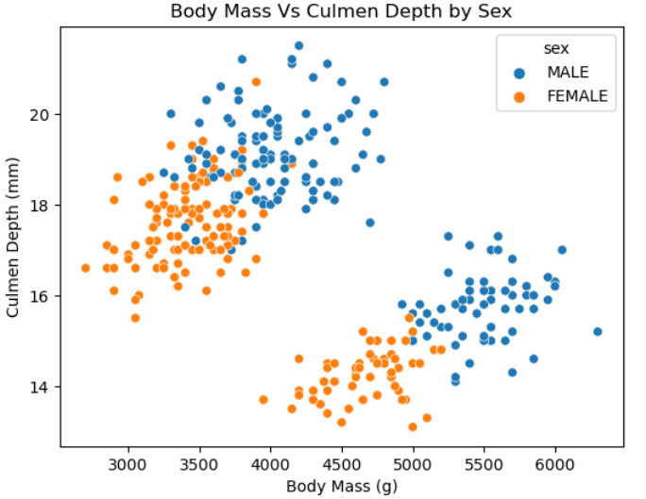
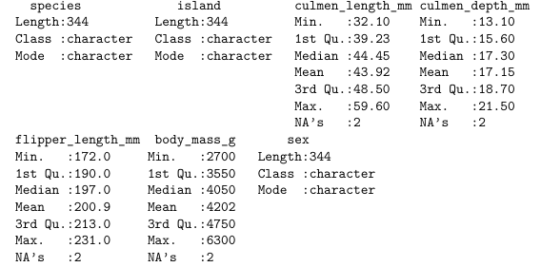
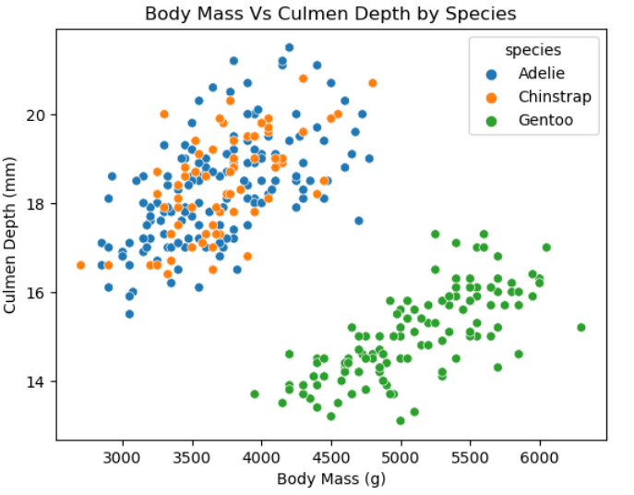
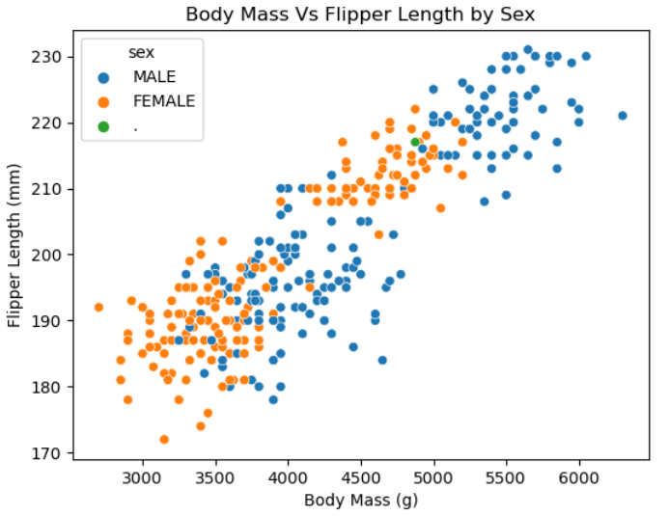
Exploratory Data Analysis
The Culmen lengths for Adelie appear to be smaller than the other two species and the Culmen depths for Gentoo appears to be smaller compared to Adelie and Chinstrap species
Culmen Depth and Body Mass for Females appears to be less than that for males
Its interesting to see that Gentoo has higher body mass compared to other species but the Culmen Depth is comparatively lower than the other two species.
A Linear Positive relation can be seen between Body mass and Culmen depth, Body mass and Flipper Length for both Males and Females and between Culmen Length and Culmen Depth for all three species.

Slide 3
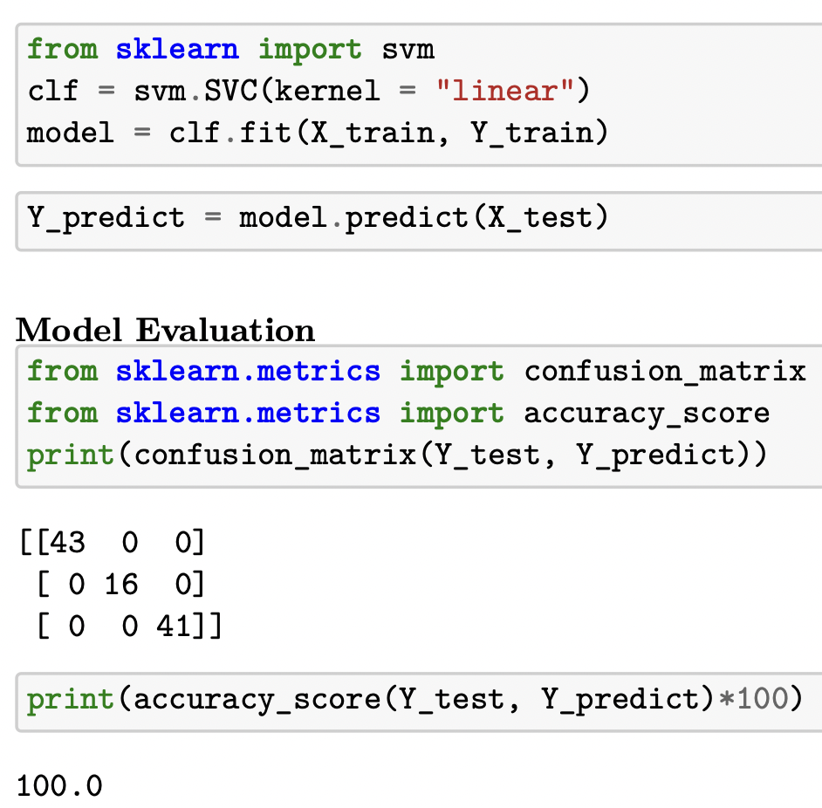
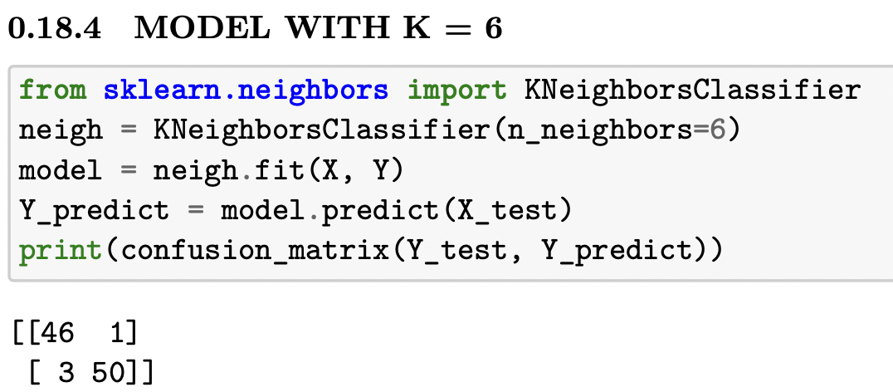
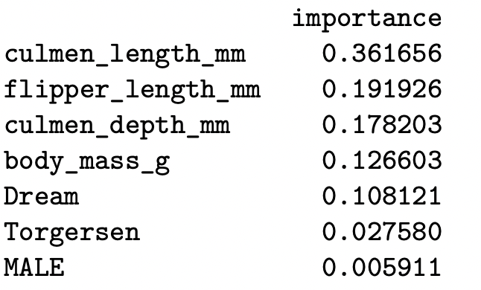
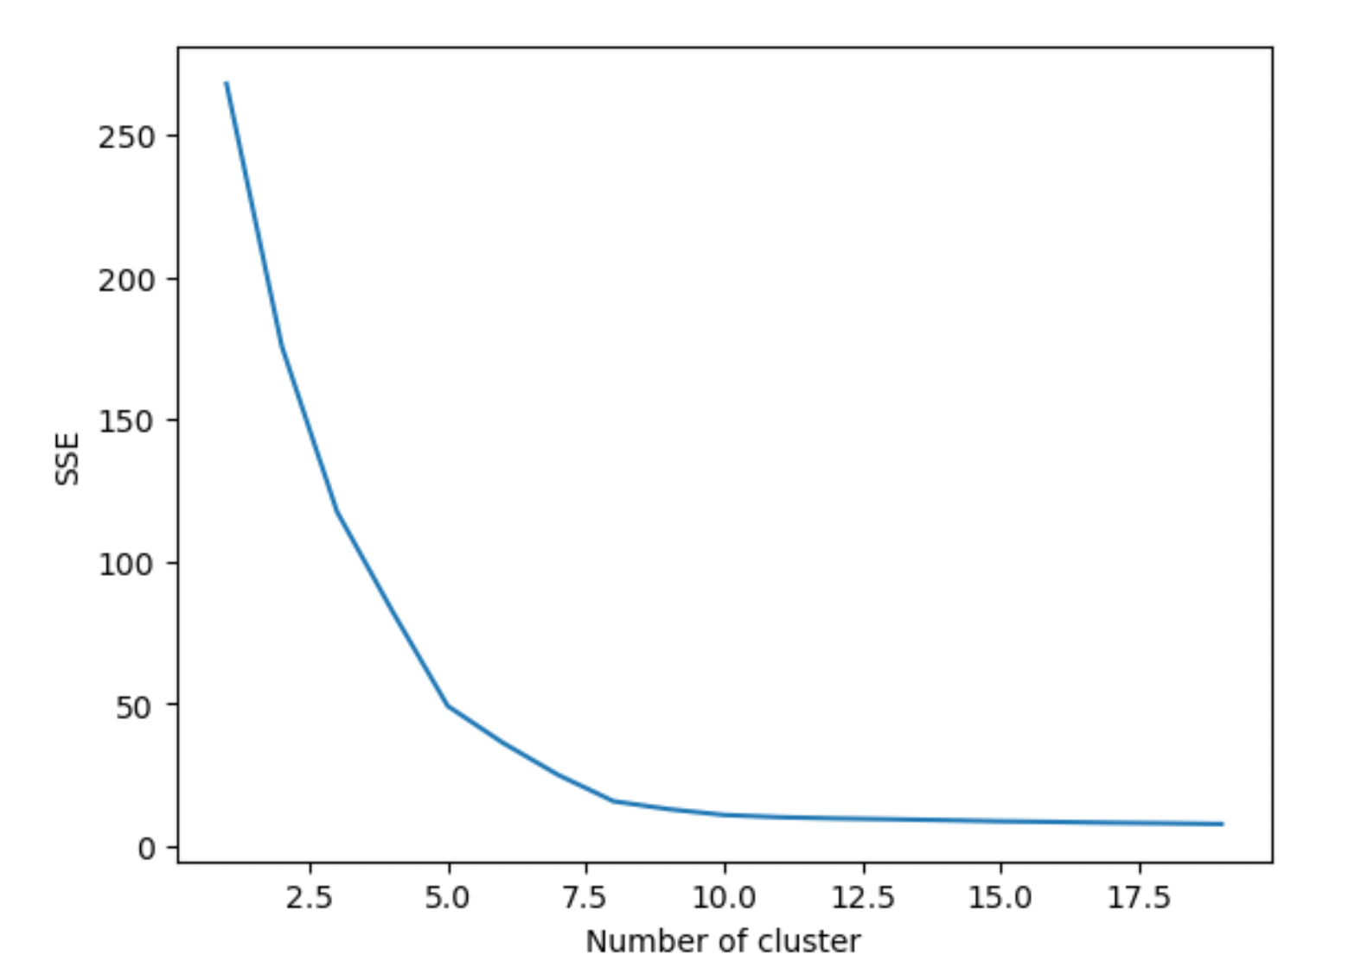
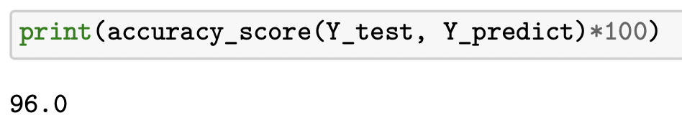
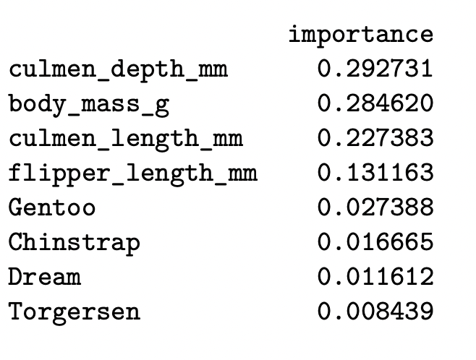
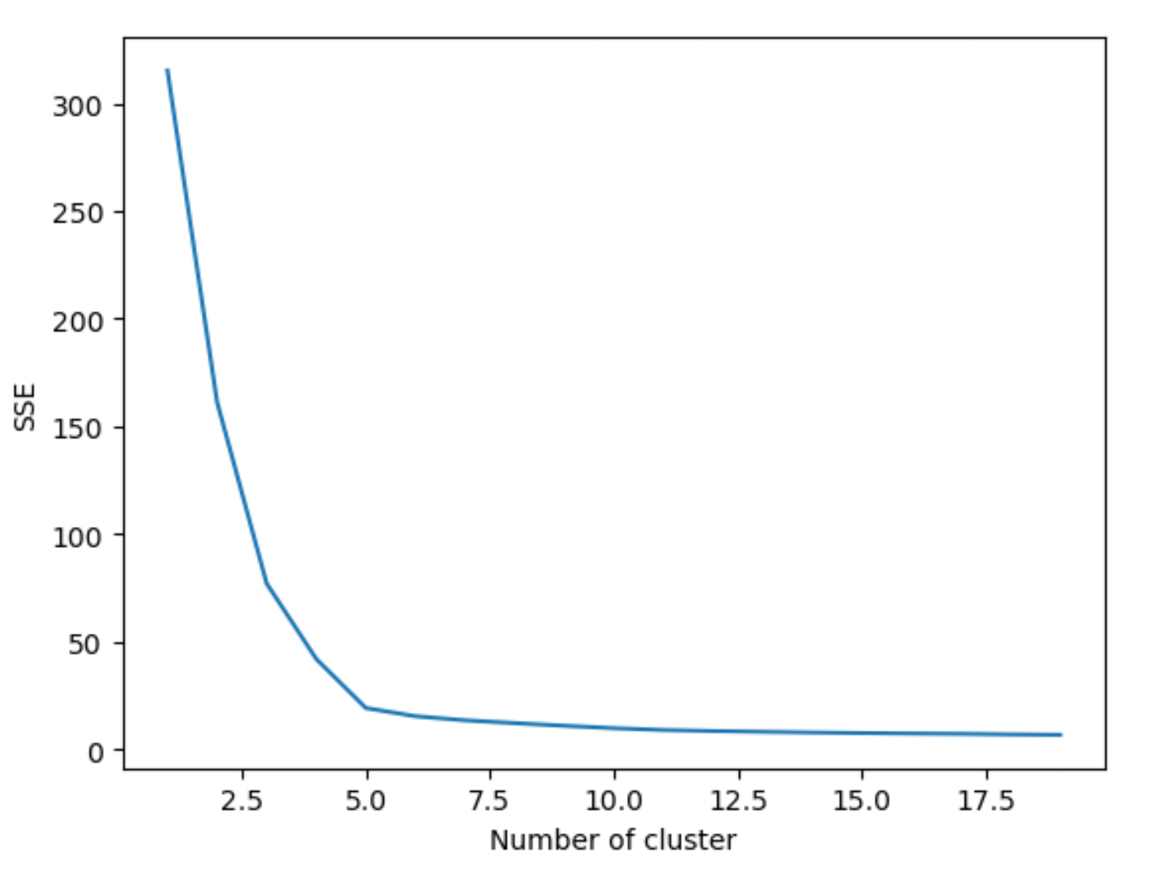
Model Summary
Species: SVM with Linear and RBF kernels and KNN classifier both predicted Species with an accuracy of 100%. The attached summary is for the SVM Linear model
Sex: KNN classifier with K=6 gave us the best accuracy of 96% out of all models considered for predicting the sex.
Highlights: It was interesting to see the most influential features for predicting species were Culmen Length, Flipper Length, Culmen Depth, whereas the ones for predicting Sex were Culmen depth, body mass and Culmen Length.
The K graphs for Clustering for both models are shown below as under. Species model showed K values in the range of 3 to 8 and the models for predicting Sex showed K values in the range of 3 to 5, by the Elbow Method.
Species
Sex

